Slide 1
Phylogenetic Analysis of the 2020 West Nile Virus (WNV) Outbreak in Andalusia (Spain)
Presented by:
1. Jimmy Nkaiwuatei
2. Mark Njama.

Slide 2
Table of content
Introduction
Objectives
Workspace preparation
The process of retrieving sequences
Phylogenetic analysis
Visualizing our data.

Slide 3
Introduction
A member of the Flavivirus genus.
transmitted in an enzootic cycle
Currently, the virus is considered a recurrent zoonosis
Phylogenetically, WNV is classified into eight lineages
Andalusian viral samples belonged to lineage 1
Notes:
West Nile virus (WNV), a member of the Flavivirus genus, is transmitted in an enzootic cycle involving birds as amplifying hosts and mosquitoes as vectors, which can ultimately be transmitted to mammals, considered dead-end hosts, causing disease outbreaks in horses and/or humans. Currently, the virus is considered a recurrent zoonosis with a wide geographic distribution. Phylogenetically, WNV is classified into eight lineages. The Andalusian viral samples belonged to lineage 1 and were relatively similar to those of previous outbreaks which occurred in the Mediterranean region. A phylogenetic analysis was performed on the obtained consensus genomes in the context of a world-wide representative set of WNVs.

Slide 4
Objectives
download the sequences
perform phylogenetic analysis
document our work on GitHub
To prepare a presentation for the same(welcome to this presentation!)
Gif by :http://blog.commlabindia.com/elearning-design/tips-to-set-learning-objectives

Slide 5

workspace preparations
Create a working directory
Initiate a git repo in terminal
Create and activate a conda environment for augur
Install augur
Install auspice
Install snakemake
Notes:
The first thing we did was create a working directory where we saved our files. we initiated a git repo this way we could share our work on GitHub
Then We then created and activated a conda environment for Augur and all our other tools

Slide 6

Nextstrain’s augur
tool for phylogenetic analysis
Commands designed for larger processing pipeline
different workflows will use different parts of the pipeline
Hadfield et al., Nextstrain: real-time tracking of pathogen evolution, Bioinformatics (2018)
Notes:
Augur is a bioinformatics tool for phylogenetic analysis. the collection of commands from the tool are designed to be used with a larger processing pipeline like snakemake Augur is composed of a series of modules and different workflows will use different parts of the pipeline. A selection of augur modules and different possible entry points are illustrated below.

Slide 7
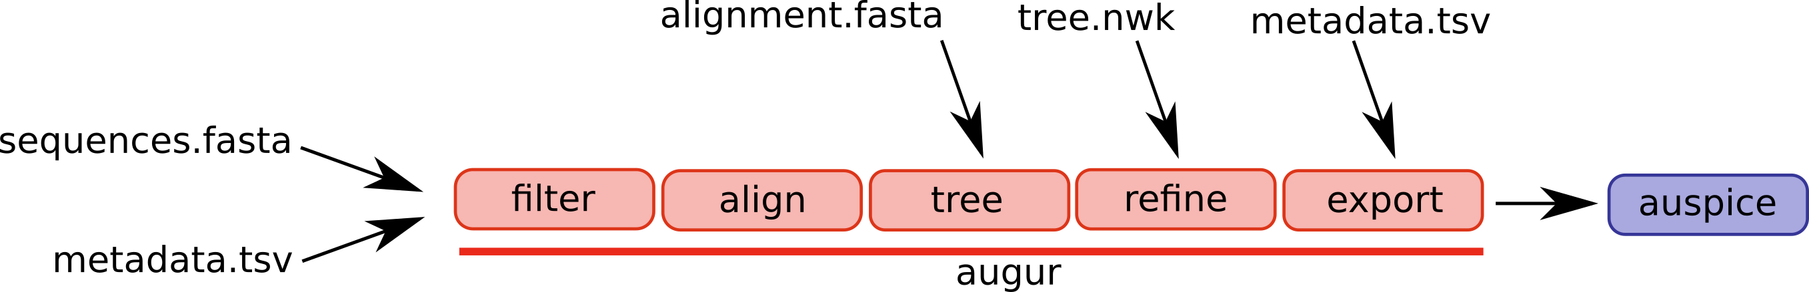
A selection of augur modules and different possible entry points are illustrated below.
Hadfield et al., Nextstrain: real-time tracking of pathogen evolution, Bioinformatics (2018)

Slide 8

Sequence retrieval
https://www.istockphoto.com/photos/genome-sequencing

Slide 9
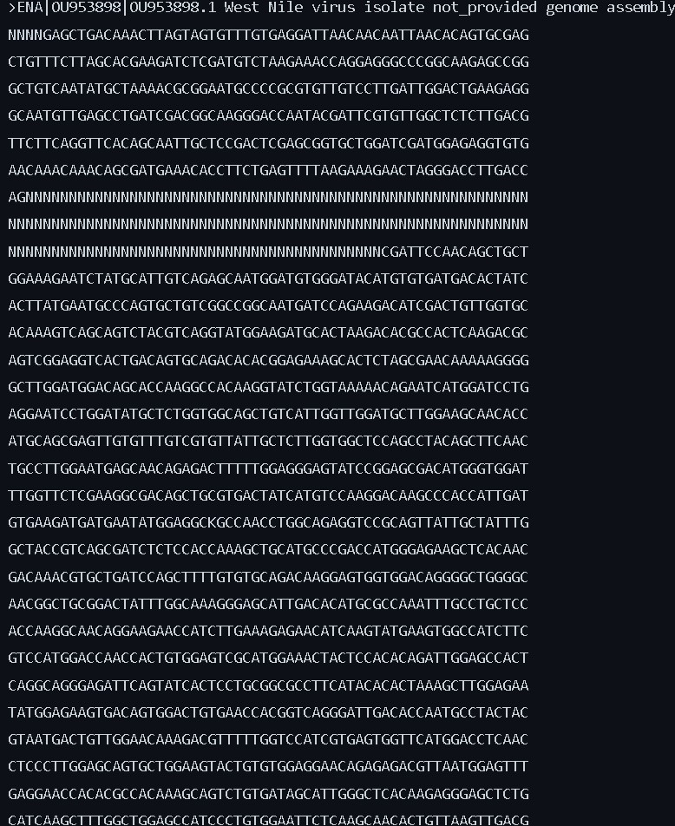
Sequence retrieval
We download the 4 sequences from EBI with wget.
The reference sequence was downloaded from NCBI and named ref.seq
worldwide representative set of WNVs sequences were obtained using batch entrez
Notes:
download the sequences with wget. The reference sequence was downloaded from NCBI and saved into a file called refseq.fasta. The fasta sequences for the worldwide representative set of WNVs sequences were obtained using batch entrez and imported into a single file called WWR_sequences.fasta accession numbers were retrieved from the viruses-13-00836-s001.zip which can be found in the Table S1.R3.xlsx. for retrieving purposes, they were saved into a text file called WWrep_accession.txt this text file was then uploaded into batch entrez.
combine the four sequences into a file that contains all the sequences then combined them with the WWR_sequences.fasta

Slide 10
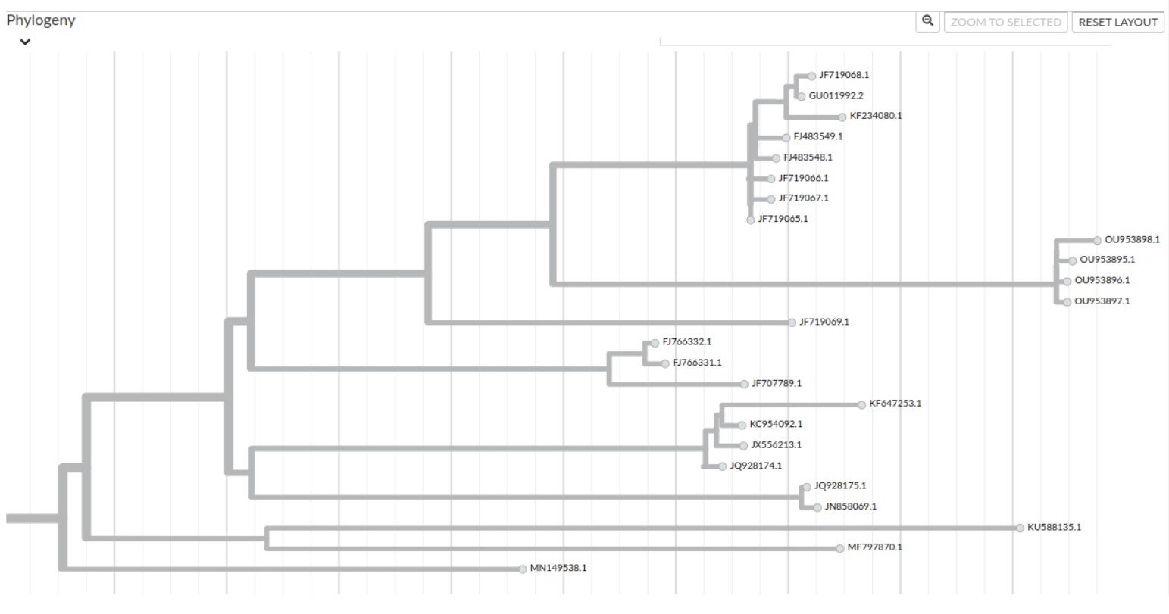
phylogenetic analysis
Notes:
The entire analysis can be run using snakemake workflow management. Snakemake breaks a workflow into a set of rules that are specified in a file called Snakefile. Each rule takes a number of input files, specifies a few parameters, and produces output files

Slide 11
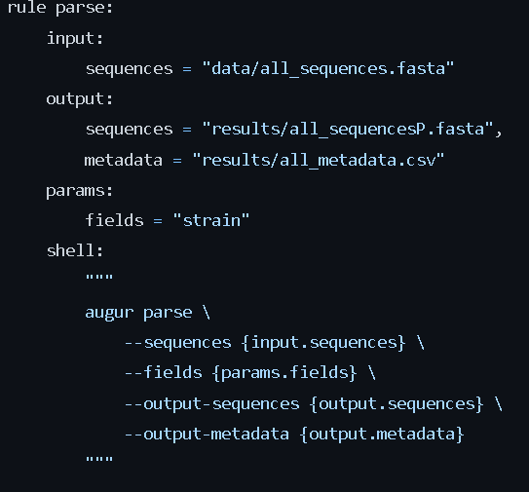
Parse
Generate metadata file
from FASTA sequence names into a TSV/CSV and separate fasta file
Notes:
Parse delimited fields from FASTA sequence names into a TSV/CSV and FASTA file using a Snakefile input in this code creates a metadata file alongside the fasta file and saved into a folder called results which will be used in subsequent steps to do this we created a Snakemake file and used the augur parse command

Slide 12
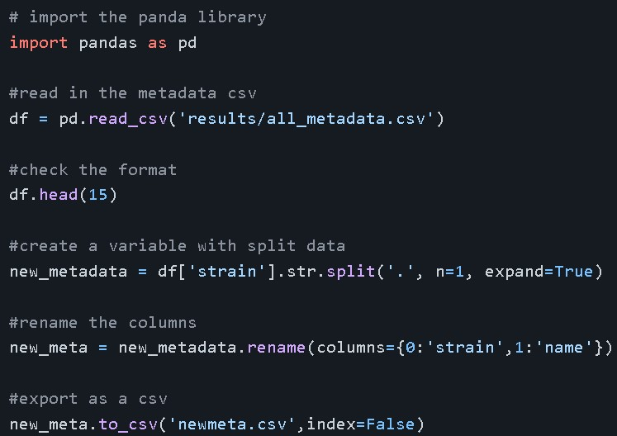
Splitting the Metadata
Created a python script to split the metadata into two seperate columns
Strain and
Name
Marked the python script as an executible file
Notes:
How to mark the py script as an exe chmod +x sample-script.py

Slide 13
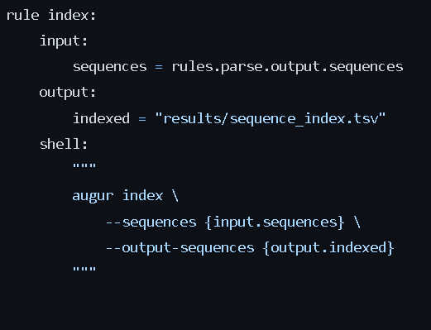
indexing
Count occurrence of bases in a set of sequences.
Helps in the filtering step

Slide 14
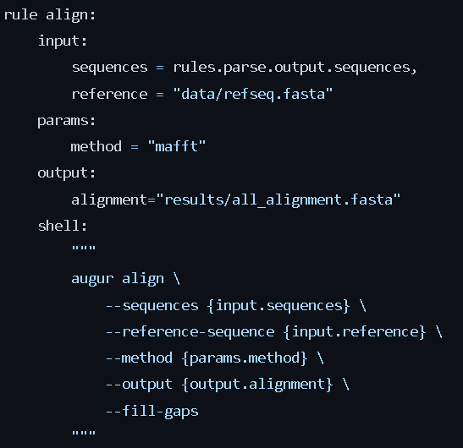
alignment
mafft is reaquired for the alignment
it is a high-speed multiple sequence alignment program.
one of the most sensitive multiple alignment methods
Notes:
for alignment mafft is required. MAFFT (Multiple Alignment using Fast Fourier Transform) and it is a high-speed multiple sequence alignment program.

Slide 15
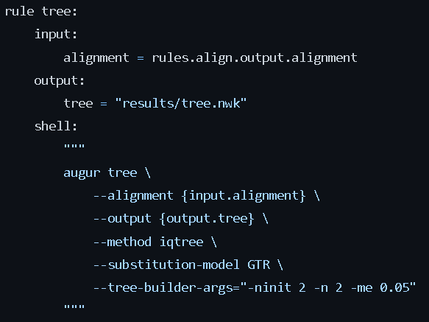
Generate tree data
Tree was recovered by maximum likelihood
Using GTR model
The parameters –tree-guilder-args allows for bootstrapping
Notes:
The phylogenetic tree was recovered by maximum likelihood, using a general time reversible model Augur version 14 + introduced --tree-builder-args which allows the user to create a tree with bootstrap values.

Slide 16
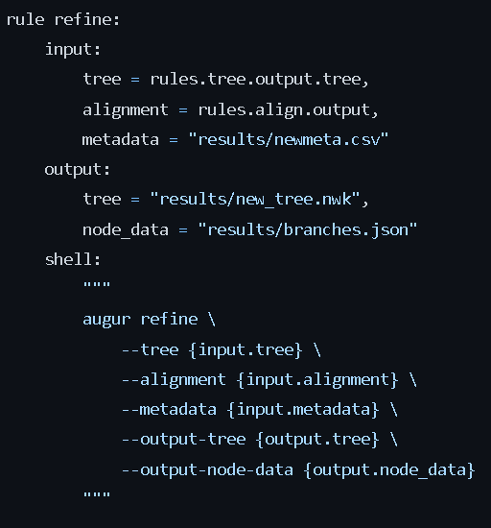
Refine
Refinement of the initial tree
Branch data estimation
Carried out by least square dating(LSD)

Slide 17
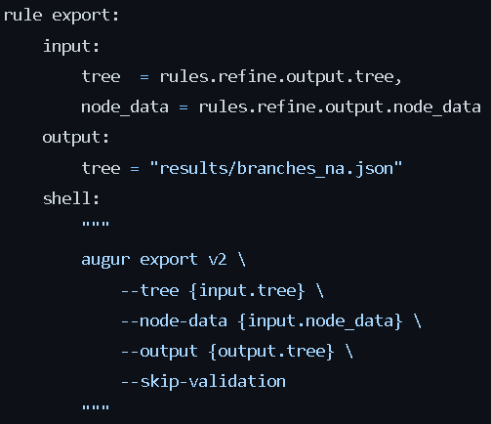
exporting
We used export v2
The output json file is what auspice uses to visualize the tree.
Auspice requires a narrative file to run the json file
A markdown file with instructions to auspice on what to do with your dataset
Notes:
The difference between augur export 1 and augur export 2 is the configuration settings

Slide 18
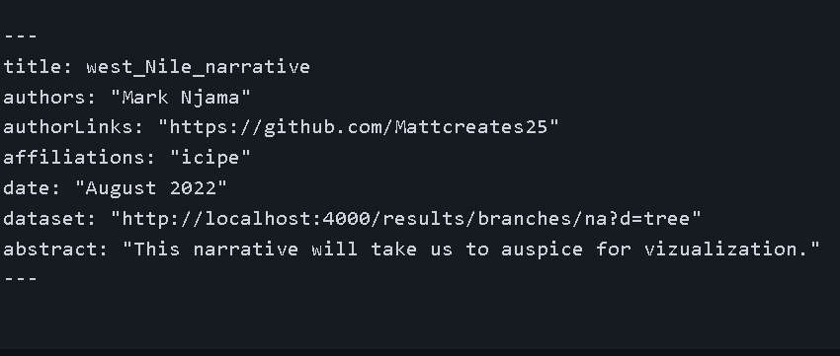
OUR TREE
After creating a narrative.md
View your tree by using
Auspice view
Open the link that is generated
Notes:
What does our tree tell us?
Sequences of the Spanish 2020 WNV outbreak OU the closest relatives from previous outbreaks in Italy and the sequence JF719069 from a lethal equine case in Andalusia (Spain) in 2010. Other Spanish outbreaks were: JF707789, from a mosquito in Huelva, FJ766331 and FJ766332 from a golden eagle in Toledo. Other related outbreaks from the Mediterranean region (Cyprus MF797870), or adjacent locations (United Arab Emirates KU588135 and Russia MN149538) are also included.

Slide 19
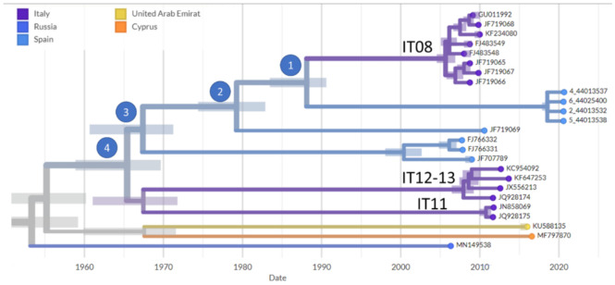
Viewing the tree
Carlos S. Casimiro-Soriguer et al., Phylogenetic Analysis of the 2020 West Nile Virus (WNV) Outbreak in Andalusia (Spain), (2021)
Notes:
This is the paper tree compared to our tree.

Slide 20
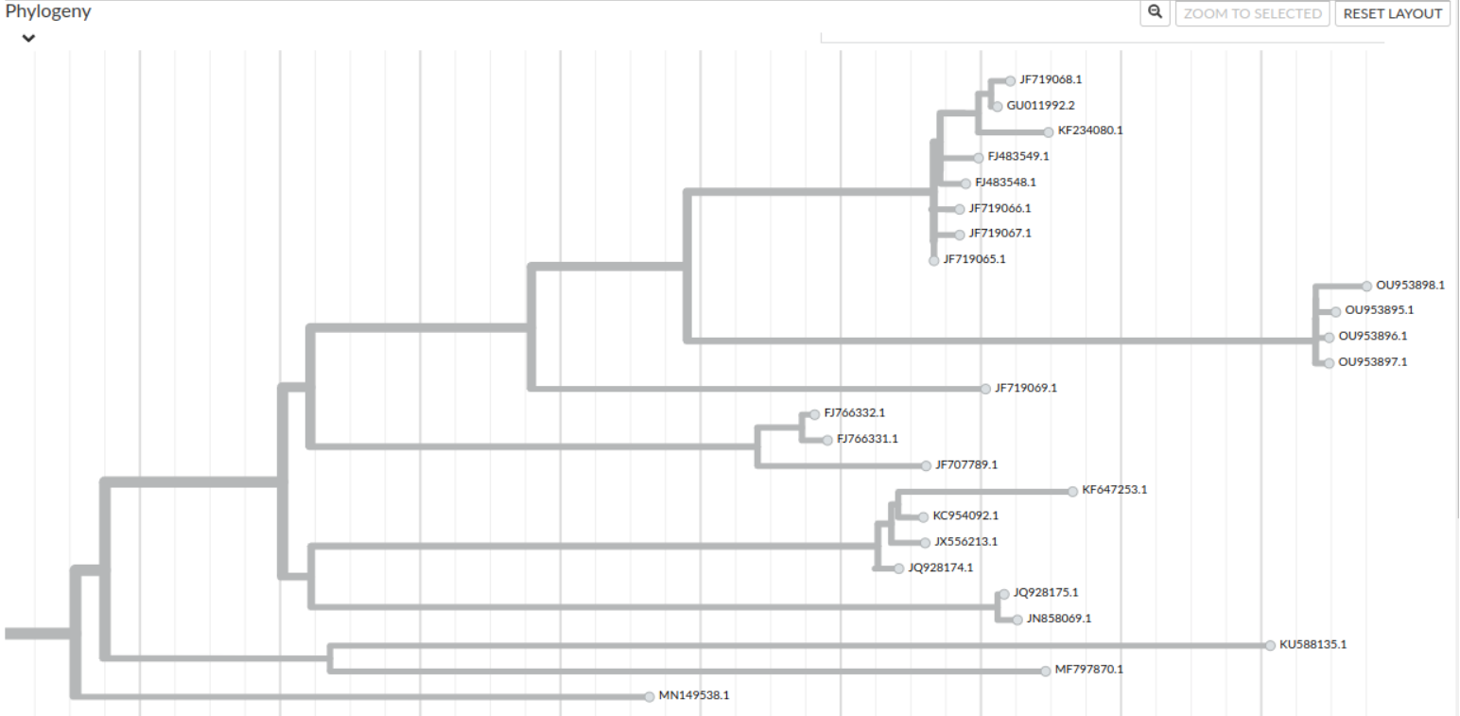
Notes:
What does our tree tell us?
Sequences of the Spanish 2020 WNV outbreak OU the closest relatives from previous outbreaks in Italy and the sequence JF719069 from a lethal equine case in Andalusia (Spain) in 2010. Other Spanish outbreaks were: JF707789, from a mosquito in Huelva, FJ766331 and FJ766332 from a golden eagle in Toledo. Other related outbreaks from the Mediterranean region (Cyprus MF797870), or adjacent locations (United Arab Emirates KU588135 and Russia MN149538) are also included.

Slide 21
non-synonymous to synonymous ratios
greater than 1 implies positive selection (driving change)
less than 1 implies stabilizing selection (acting against change)
ratio of exactly 1 indicates neutral (i.e. no) selection
Notes:
The K_{a}/K_{s} ratio is used to infer the direction and magnitude of mutations acting on protein coding genes. A ratio greater than 1 implies positive or Darwinian selection (driving change); less than 1 implies purifying or stabilizing selection (acting against change); and a ratio of exactly 1 indicates neutral (i.e. no) selection.

Slide 22
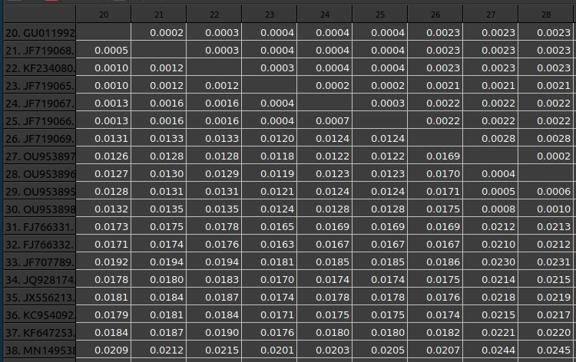
Genetic distances observed
08-09 outbreak (italy)
2021 outbreak in spain
2012-13 Italian outbreak
Notes:
The phylogenetic analysis confirms the initial assignment to lineage 1. The table provides the estimated genetic distances among the WNV genome sequences, values are the average distances between all the sequences in the cluster and the compared sequence. the sequences GU011992, JF719068, KF234080, FJ483549, FJ483548, JF719065, JF719067, and JF719066, from the 2008–2009 Italian outbreak. additionally, the sequences KC954092, KF647253, JX556213, and JQ928174 from the 2012 and 2013 Italian outbreaks. the 3 Sequences JN858069 and JQ928175 are from the 2011 Italian outbreak.

Slide 23
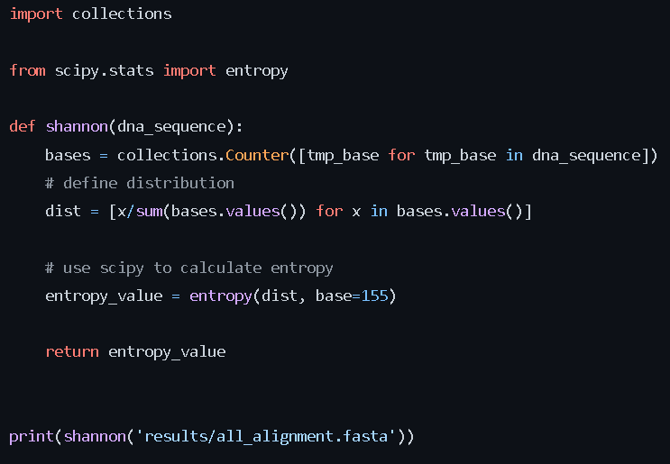
Shannon entropy
Variability calculated using shannon entropy
Measures the variability of nucleotides within all our sequences.
Our entropy value was 0.5032..
What does this mean?
Notes:
The variability along the viral genomes was estimated using the Shannon entropy. The Shannon entropy can measure the uncertainty of a random occuring nucleotide in a sequence.
Our entropy value was 0.5032... What does this mean? high entropy means that the data are spread out as much as possible while low entropy means that the datasets are nearly all concentrated. For random data, the Shannon entropy value is 1. For deterministic signals, it is between 0 and 1

Slide 24
Thank you for your time questions? https://github.com/Mattcreates25/West_nile_virus
Notes:
Our work can be found in the link https://github.com/Mattcreates25/West_nile_virus

